Slide 1
Office of Coast Survey
Engagement with ECS and PPUs
To advance E-Navigation
Rear Admiral Shepard M. Smith
^{Office of Coast Survey}
National Oceanic and Atmospheric Administration

Slide 2
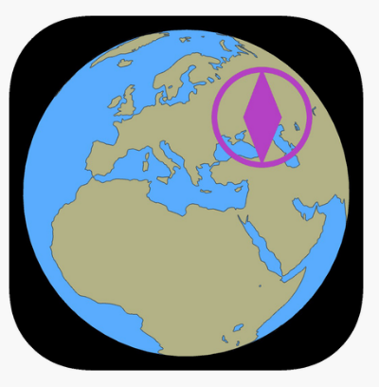
Rose Point and SeaIQ
Rose Point produces navigation systems to serve both recreational boaters and professional mariners.
^{Office of Coast Survey}
National Oceanic and Atmospheric Administration
Notes:
Coastal Explorer is a PC-based charting and navigation software for recreational boaters, which provide the ability to both plan and navigate a voyage It provides compatibility with both NOAA ENCs and ENCs.
Rose Point ECS is also a PC-based software package and is the primary navigation software used by inland vessels in the United States.

Slide 3
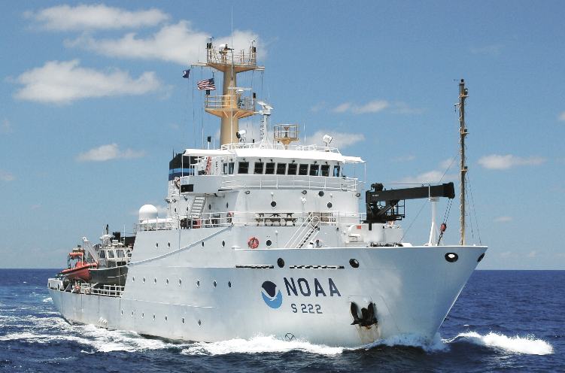
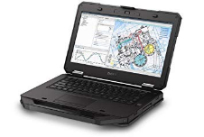
NOAA Fleet Usage
Most NOAA ships have both ECDIS and Rosepoint ECS system.
Most users prefer Rosepoint for ease of use and additional functionality
New pilot program to equip NOAA ships with fully-loaded Surface tablets running Rosepoint as a deep backup for navigation
^{Office of Coast Survey}
National Oceanic and Atmospheric Administration
Notes:
Recently, an proof-of-concept effort has been underway to utilize Rose Point as a emergency backup to paper charts on the a NOAA ship. Rose Point was purchased and installed on a waterproof, ruggedized tablet with 15 hours of battery life. The idea is that during an abandon ship or other emergency situation, the tablets, which have been kept updated with the latest chart updates, could be used instead of paper charts. Rose Point was chosen for ease of use and to enable standardization within the fleet.

Slide 4
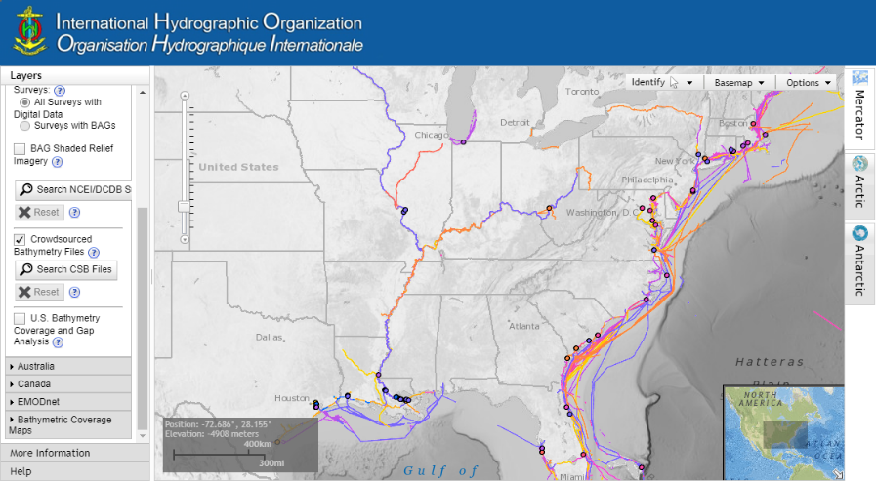
Crowdsourced Bathymetry
^{Office of Coast Survey}
National Oceanic and Atmospheric Administration
Notes:
The relationship with Rose Point on CSB started back in 2013 or 2014, when a proof-of-concept project was conducted onboard the NOAA Ship Ferdinand Hassler. During this project, transit to and from the working grounds were logged attributes, such as depth, time, ad position were able to be parsed out of the log file. Based on this success and the need for data to populate the nascent DCDB at NCEI, NOAA contacted Rose Point about building out a volunteer CSB solution. NOAA worked with Rose Point to develop metadata and data transfer standards. Rose Point implemented a trial system in the Rose Point Labs, where users to volunteer to submit their data and they worked out a system to push the data o the DCDB in Boulder, CO. It worked so well that Rose Point ended up implementing this functionality as a regular feature of their software. Since then, millions of data points have been submitted.
Right now, we aren’t doing anything with the data, except archiving it. We would like to process the data to see if we may have additional requirements (metadata and format). However, the data is all file based and not in a point store, which means that it is not easy to process without developing some automated scripts. We would also like to use the data for reconnaissance, chart comparison, chart adequacy, and to ground truth hydro health. Another idea would also be to use the data for charting in areas that currently do not have data (like the Yukon River).

Slide 5
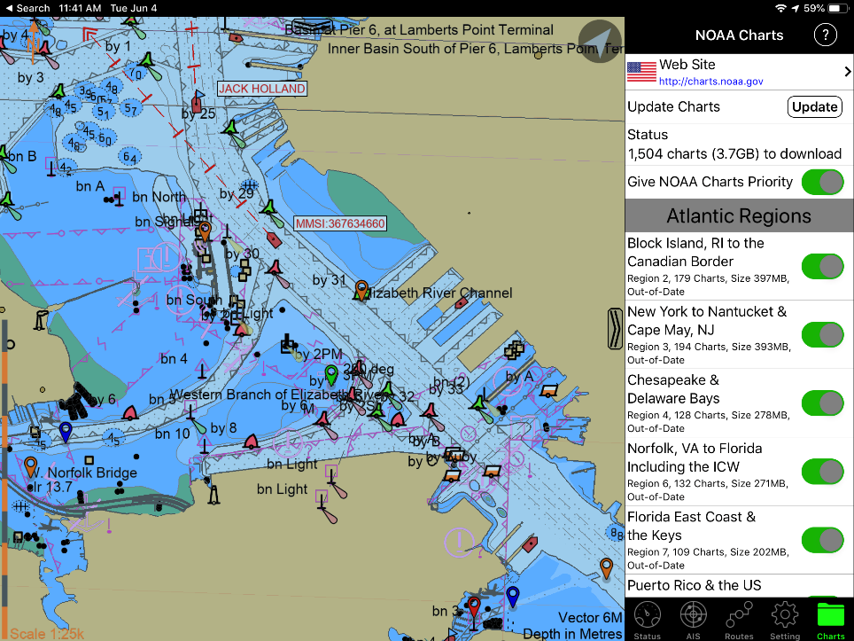
SEAIQ-PPU
^{Office of Coast Survey}
National Oceanic and Atmospheric Administration
Notes:
Rose Point uses many marine forecast text files from ftp://tgftp.nws.noaa.gov/data/forecasts/marine/ and ftp://tgftp.nws.noaa.gov/data/raw/fq/*.txt. We also use forecasts generated by http://forecast.weather.gov/MapClick.php. They also use NEXRAD images from http://radar.weather.gov/ridge/RadarImg, download METAR observations from http://tgftp.nws.noaa.gov/data/observations/metar/cycles and provide river stage informaiton to inland commerical users.

Slide 6
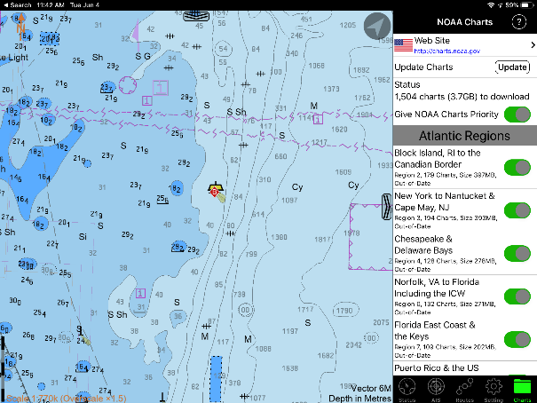
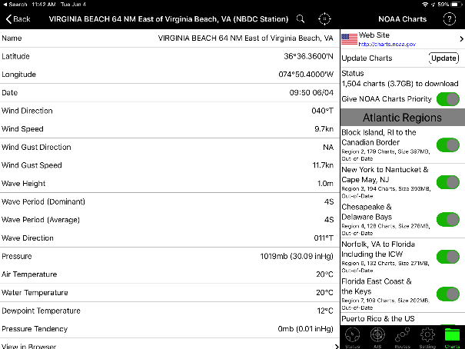
SEAIQ-PPU
^{Office of Coast Survey}
National Oceanic and Atmospheric Administration
Notes:
Rose Point uses many marine forecast text files from ftp://tgftp.nws.noaa.gov/data/forecasts/marine/ and ftp://tgftp.nws.noaa.gov/data/raw/fq/*.txt. We also use forecasts generated by http://forecast.weather.gov/MapClick.php. They also use NEXRAD images from http://radar.weather.gov/ridge/RadarImg, download METAR observations from http://tgftp.nws.noaa.gov/data/observations/metar/cycles and provide river stage informaiton to inland commerical users.

Slide 7
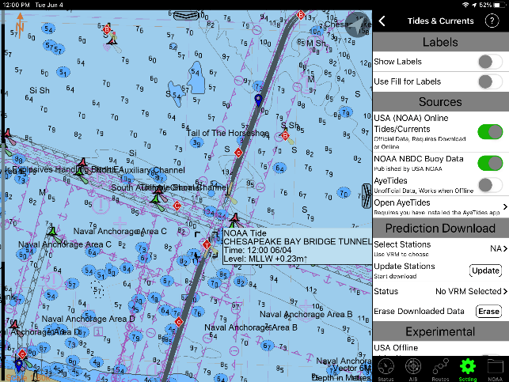
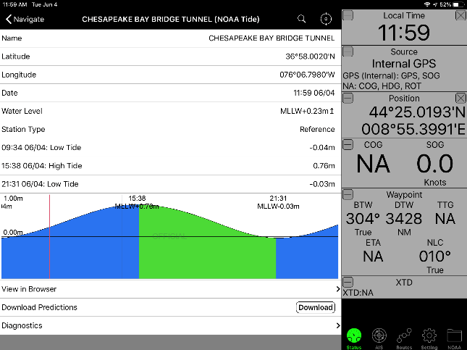
Tides and Currents
^{Office of Coast Survey}
National Oceanic and Atmospheric Administration
Notes:
Tides and currents — Rose Point used to use “perpetual” data mentioned at https://tidesandcurrents.noaa.gov/faq2.html#65, but have recently stopped because converting the data to something they could use was a very complicated process and we were not able to exactly match the predictions shown on the https://tidesandcurrents.noaa.gov which led to customer support issues. Now they are “scraping” the information from that site in both the PDF and TXT formats. They deliver the PDF to their commercial customers and the TXT files are converted to a format that our software can use to approximate predictions at arbitrary times. The areas of your site that we scrape are “NOAA Tide Predictions” (https://tidesandcurrents.noaa.gov/tide_predictions.html_ and “NOAA Current Predictions” (https://tidesandcurrents.noaa.gov/noaacurrents/Regions).

Slide 8
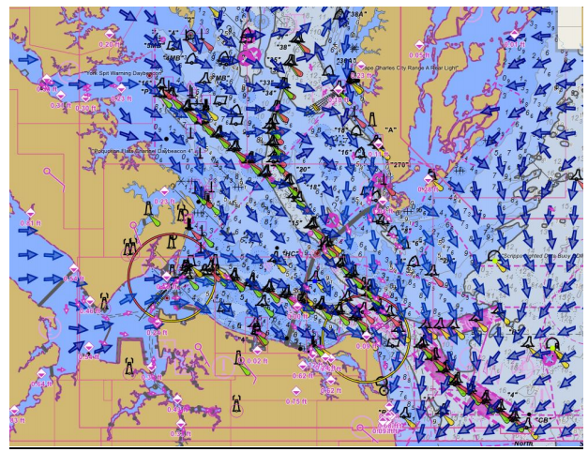
Surface Currents/S-111
^{Office of Coast Survey}
National Oceanic and Atmospheric Administration
Notes:
Over the past two years, NOAA has been working with Rose Point to incorporate surface currents into their software packages. Currently they are able to ingest surface currents in a GRIB format, which NOAA has provided for the Chesapeake Bay, San Francisco, Delaware River, and New York. The effort to use the GRIB format was a good proof of concept. NOAA has since been working with Rosepoint to sunset the use of the GRIB format and instead switch to the international S-111 standard. NOAA will cease providing data in GRIB format at the end of 2019.

